Slide 1
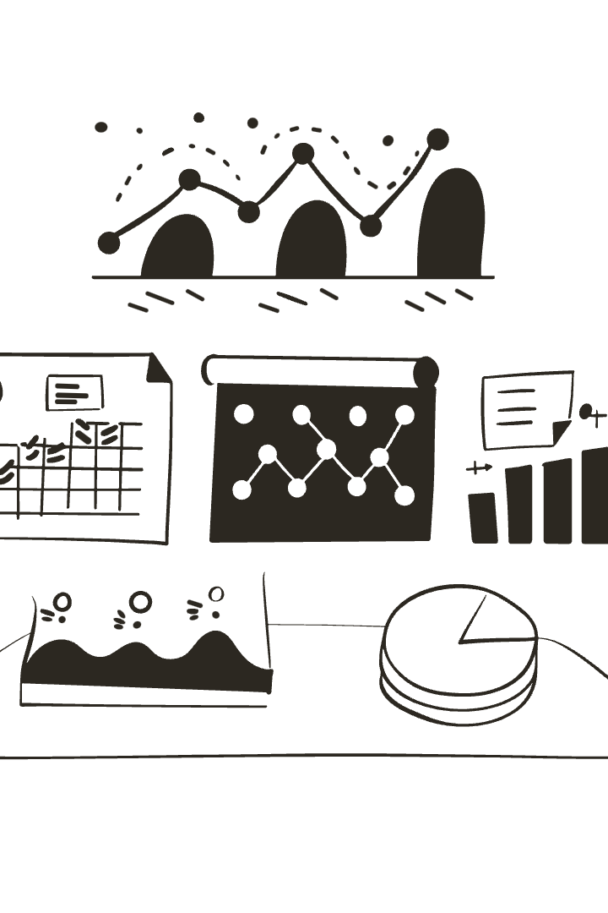
Lead Scoring Case Study: Improving Conversion Prediction – X Education
This presentation outlines our comprehensive analysis of lead conversion factors for an educational company. We examined a dataset of 9,240 leads with 37 variables to build a predictive model that identifies which leads are most likely to convert into paying customers.
Our analysis follows a systematic approach: data cleaning, exploratory data analysis, feature engineering, model building with logistic regression, and evaluation. The findings provide actionable insights to optimize the lead nurturing process and improve conversion rates.
by Duy Pham and Vy Pham

Slide 2
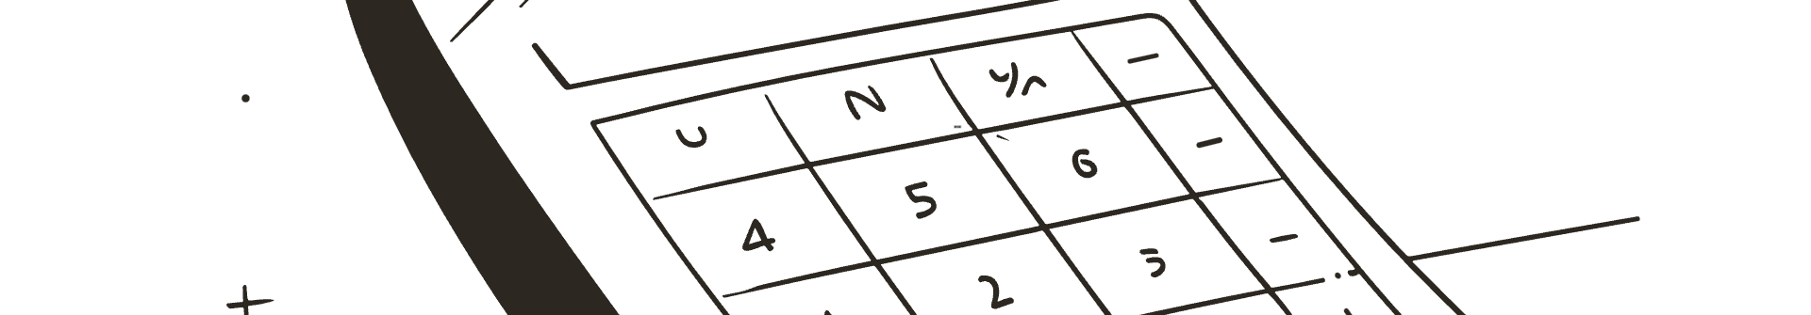
Project Overview and Objectives
1
Business Context
2
Problem Statement
3
Project Goal
The education company X Education sells online courses to industry professionals. The company markets its courses on several websites and search engines. When these individuals land on the website, they might browse courses or fill out forms for the course or watch videos.
The conversion rate of leads to paying customers is currently low at around 30%. The company needs to identify the most promising leads (hot leads) to focus their sales efforts efficiently.
Build a lead scoring model that assigns a score to each lead, indicating the likelihood of conversion. This will help the sales team prioritize leads with higher conversion probability.

Slide 3
Dataset Description
Dataset Size
Key Variables
The initial dataset contained 9,240 leads with 37 variables, including both categorical and numerical features. After cleaning, we retained approximately 69% of the original data (6,373 records).
The dataset includes lead source information, engagement metrics (time spent on website, total visits), lead details (occupation, specialization), and interaction history (last activity, notable actions).
The target variable is "Converted," which indicates whether a lead eventually became a paying customer (1) or not (0).
We also derived new metrics like average time per visit and average time per page view to better understand user engagement patterns.

Slide 4




Data Cleaning: Handling Missing Values
Step 1: Identify Missing Data
Step 2: Remove Low-Value Columns
Several columns had significant missing values. For example, "Lead Quality" had 51.6% missing values, while "Asymmetrique Activity Index" had 45.6% missing values.
Columns with over 3,000 missing values (>32% of the dataset) were dropped as they provided insufficient information for meaningful analysis.
1
2
Step 3: Address Remaining Nulls
Step 4: Handle 'Select' Values
Many categorical variables contained 'Select' as a value, indicating no selection was made. These were treated as missing values during the analysis.
For key variables with fewer missing values, we removed the specific rows with nulls rather than losing the entire feature. This balanced data completeness with information retention.
4
3

Slide 5

Handling Categorical Variables
Identification
1
We identified all object-type columns in the dataset that needed to be converted to numerical format for modeling. This included variables like Lead Origin, Lead Source, and Specialization.
2
Value Assessment
For each categorical variable, we examined value counts to understand distribution. Variables with highly imbalanced classes (e.g., 99% "No" responses) were dropped as they provided little discriminatory power.
Dummy Variable Creation
3
We used one-hot encoding to convert categorical variables into binary indicators. For multilevel variables like Specialization, we created multiple binary columns, dropping the first level to avoid multicollinearity.
4
Final Preparation
After encoding, we had a much wider dataset with 77 predictor columns ready for modeling, with all categorical information properly represented numerically.

Slide 6

Feature Engineering
Derived Engagement Metrics
Feature Scaling
We created new features to better capture user engagement: "Avg_Time_Per_Visit" (Total Time Spent / Total Visits) and "Avg_Time_Per_View" (Total Time Spent / Total Page Views). These metrics provide deeper insights into how intensively leads interact with the website.
Numerical variables with different scales were normalized using MinMaxScaler. This ensures that variables like "Total Time Spent on Website" (ranging from 0-2272) don't overshadow variables with smaller ranges during model training.
Feature Selection
We used Recursive Feature Elimination (RFE) to identify the most relevant predictors, starting with all variables and iteratively removing the least important ones until reaching 15 optimal predictors.

Slide 7



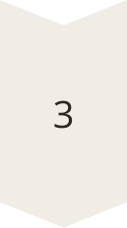
Correlation Analysis
Strong Positive Correlations
Total Time Spent on Website and Conversion showed a positive correlation of 0.32, indicating that leads who spend more time exploring the site are more likely to convert. Similarly, TotalVisits and Page Views Per Visit showed a moderate correlation of 0.49.
Channel Analysis
Lead sources showed varying correlation with conversion. The "Welingak Website" channel had one of the strongest positive associations with conversion, while certain other channels showed negative correlations.
Activity Correlations
Last activities like "Had a Phone Conversation" and "SMS Sent" correlated positively with conversion, suggesting that direct communication with leads significantly improves conversion chances.

Slide 8
Model Building Approach
Model Refinement
Logistic Regression
We iteratively improved the model by removing variables with high p-values (>0.05) or high Variance Inflation Factors (VIF), which indicate multicollinearity. This resulted in our final model with 11 predictors.
Feature Selection
We chose logistic regression as our modeling technique since it provides both predictions and interpretable coefficients. This allows us to understand which factors most heavily influence lead conversion.
Data Splitting
Using Recursive Feature Elimination (RFE), we identified the 15 most important predictors from the large feature set. This helps create a simpler, more interpretable model while maintaining predictive power.
We divided the dataset into training (70%) and testing (30%) sets to ensure unbiased evaluation. This gave us 4,461 observations for training and 1,912 for testing the model.

Slide 9




Key Predictors of Lead Conversion
Time Spent on Website
Lead Add Form
Phone Conversation
Leads who came through the Lead Add Form had much higher conversion rates (coefficient: 4.02). This suggests that leads who take the time to fill out detailed forms demonstrate higher intent and commitment.
Leads who had a phone conversation with the sales team were significantly more likely to convert (coefficient: 2.84). This highlights the importance of direct, personal communication in the conversion process.
This emerged as the strongest predictor with a coefficient of 5.76. For every standardized unit increase in time spent on the website, the log-odds of conversion increase by 5.76, translating to significantly higher conversion probability.

Slide 10
Negative Predictors of Conversion
Average Time Per Visit
Email Preferences
Student Occupation
Interestingly, while total time spent on the website is positive, the average time per visit shows a negative coefficient (-3.79). This suggests that multiple shorter visits are more valuable than fewer longer visits. It may indicate that leads who need to think about the decision over multiple sessions are more serious.
Leads who selected "Do Not Email" were significantly less likely to convert (coefficient: -1.42). This suggests that willingness to receive communications is an important indicator of interest and openness to the offering.
Leads who identified as students had lower conversion rates (coefficient: -2.37), as did unemployed individuals (-2.53). This likely reflects financial constraints or different decision-making priorities among these groups.

Slide 11

Model Performance: Accuracy and Precision
79.1%
Accuracy (Default)
Using a standard 0.5 probability threshold
79.5%
Accuracy (Optimized on Train set)
With threshold at 0.42 (optimal cutoff)
79.2%
Precision
Among predicted conversions, actual rate
77.8%
Recall
Ability to find all actual conversions
Our model demonstrates strong performance across multiple metrics. The accuracy increased from 79.1% to 79.5% when we optimized the threshold from 0.5 to 0.42. This means that for approximately 8 out of 10 leads, our model correctly predicts whether they will convert or not. The precision of 79.2% indicates that when our model predicts a lead will convert, it's right about 78% of the time.

Slide 12

ROC Curve Analysis
The Receiver Operating Characteristic (ROC) curve plots the true positive rate against the false positive rate at various threshold settings. Our model achieved an Area Under the Curve (AUC) of 0.86, which indicates excellent discriminative ability. This means the model is very good at distinguishing between leads that will convert and those that won't.
The ROC curve helped us identify the optimal probability threshold of 0.42, which balances sensitivity (finding actual conversions) and specificity (avoiding false positives). This threshold optimization is crucial for business applications where different types of errors may have different costs.

Slide 13

Threshold Optimization: Precision-Recall Tradeoff
When determining the optimal probability threshold for classifying leads, we faced a critical tradeoff between precision and recall. Lower thresholds increase recall (finding more potential conversions) but decrease precision (more false positives). Higher thresholds do the opposite.
After analyzing this tradeoff, we selected 0.44 as our final threshold for the test set, which achieved the best balance of precision (78.2%) and recall (77.2%). This optimization ensures that sales resources are allocated efficiently while still capturing a high percentage of potential conversions.

Slide 14





Lead Source Impact on Conversion
Welingak Website
1
Highest conversion coefficient (2.15)
Olark Chat
2
Strong positive impact (1.28)
Reference
3
Moderate positive impact
Google
4
Baseline conversion rate
Direct Traffic
5
Lower conversion potential
Different lead sources showed varying effectiveness in generating conversions. The Welingak Website emerged as the most valuable channel with a coefficient of 2.15, indicating leads from this source are significantly more likely to convert. Olark Chat was also highly effective (coefficient: 1.28), suggesting that interactive engagement channels produce higher-quality leads.

Slide 15



Communication Channel Effectiveness
Phone Conversations
SMS Communication
Email Engagement
Having a phone conversation with a lead was one of the strongest predictors of conversion (coefficient: 2.84). This direct, personalized communication method creates a connection that significantly improves conversion chances.
Leads who received SMS communications showed higher conversion rates (coefficient: 1.16). This suggests that text messaging is an effective channel for engaging with potential customers and driving conversions.
Leads who opened emails showed moderate conversion increases. Conversely, those who opted out of emails were much less likely to convert (-1.42). This highlights the importance of email as a nurturing channel.

Slide 16
Demographic Insights: Occupation Impact
0.68
-2.53
Working Professional
Unemployed
Highest conversion propensity
Lowest conversion likelihood
Positive Conversion Indicators
Negative Conversion Indicators
Working professionals showed the highest propensity to convert (coefficient: 0.68), suggesting they have both the decision-making authority and financial means to purchase courses. Businessmen showed a slight positive impact (coefficient: 0.12) on conversion likelihood.
Students and unemployed individuals were significantly less likely to convert (coefficients: -2.37 and -2.53 respectively). Housewives also showed a slightly negative tendency (coefficient: -0.25).
This data suggests that targeting efforts should prioritize working professionals. For student segments, different pricing or financing options might be needed to improve conversion rates.

Slide 17

Engagement Metrics: Time and Visits
Total Time Spent (Positive)
Average Time Per Visit (Negative)
Visit Pattern Implications
The total time a lead spends on the website was the strongest positive predictor of conversion (coefficient: 5.76). This indicates that engaging content that keeps visitors on the site longer directly contributes to higher conversion rates.
Interestingly, the average time per visit showed a negative relationship with conversion (coefficient: -3.79). This suggests that multiple shorter visits may be more valuable than fewer lengthy visits.
The combination of these findings suggests an ideal engagement pattern: leads who return to the site multiple times, even for shorter sessions, show higher intent and conversion probability than those who browse extensively in a single visit.

Slide 18

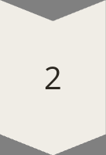
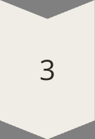
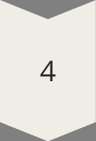
Key Recommendations
Optimize Lead Sources
Increase investment in high-converting channels like Welingak Website and Olark Chat. Consider reducing spend on lower-performing channels or revamping their approach to improve quality.
Enhance Communication Strategy
Prioritize phone conversations for high-potential leads. Implement a robust SMS communication strategy as a complement to email marketing. Ensure email content is engaging to improve open rates.
Improve Website Engagement
Design the website to encourage repeat visits rather than one-time lengthy browsing. Create content that builds interest over multiple sessions. Use remarketing to bring visitors back to the site.
Segment Marketing Approach
Tailor marketing strategies based on occupation segments. Focus primary efforts on working professionals while developing special offers or financing options for student and unemployed segments.

Slide 19





Implementation Strategy & Next Steps
Resource Optimization
Score Implementation
Integrate scores into CRM systems and redesign the lead assignment process to prioritize high-potential leads. Adjust the threshold depends on the manpower and strategies
Deploy the lead scoring model in production to automatically generate conversion probability scores for all new leads
2
1
Marketing Channel Optimization
3
Reallocate marketing budget based on channel performance insights from the model
5
Model Refinement
Performance Monitoring
Continuously update the model with new data and refine based on performance feedback
4
Track key metrics including model accuracy, lead-to-customer conversion rates, and sales efficiency
To maximize the impact of our lead scoring model, we recommend a phased implementation approach. Begin by using the model to score and prioritize incoming leads, followed by integrating these scores into your existing CRM and sales processes. Continuously monitor the model's performance and refine it as new data becomes available.
Moreover, base on the strategies of each period, the threshold can be adjusted to adapt with the resource at the same time (base on subject questions)

